Slide 1
Development of a close quarter, collision resistant drone
Configuration Selection

Slide 2
Contents
Contents
Introduction
Fundamentals of Flight Theory
Selection Parameters
Standard Rotorcraft Configurations
Initial Chosen Concepts

Slide 3
Introduction
Why Drones
Easy to navigate complex terrains safely and quickly.
Computing power now allows for complex control.
More freedom in 3D space than ever before.
Issues
Close quarter environments.
Limited flight times.

Slide 4
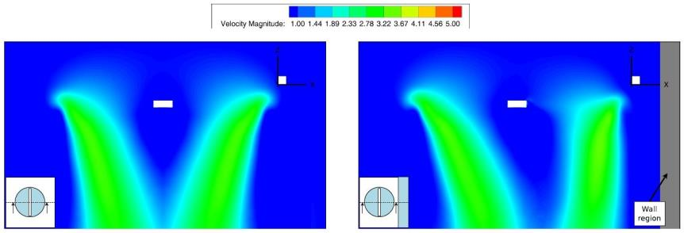
Introduction
Near Wall Effect

Slide 5
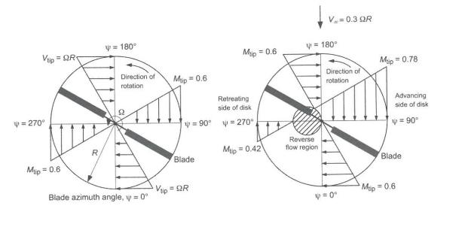
Fundamentals of Flight Theory
Velocity Components of a Rotor
Notes:
Different tip velocities
Max speed limitation

Slide 6
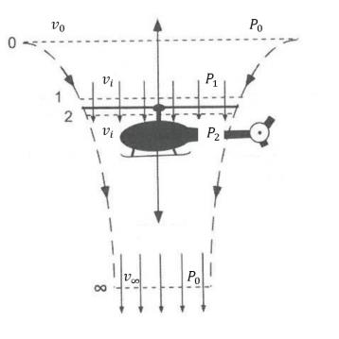
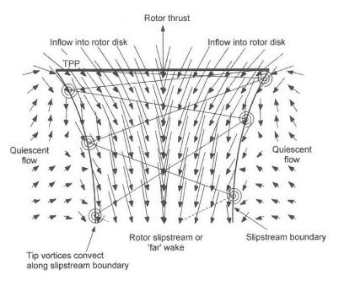
Fundamentals of Flight Theory
Momentum Theory in Hover
Wake Boundary
Notes:
Thrust created by the difference in Pressure between P2 and P1. Subscripts: 0 = Quiescient
1 = Just before rotor
2 = Just after rotor
inft = Far wake (one rotor diameter)

Slide 7
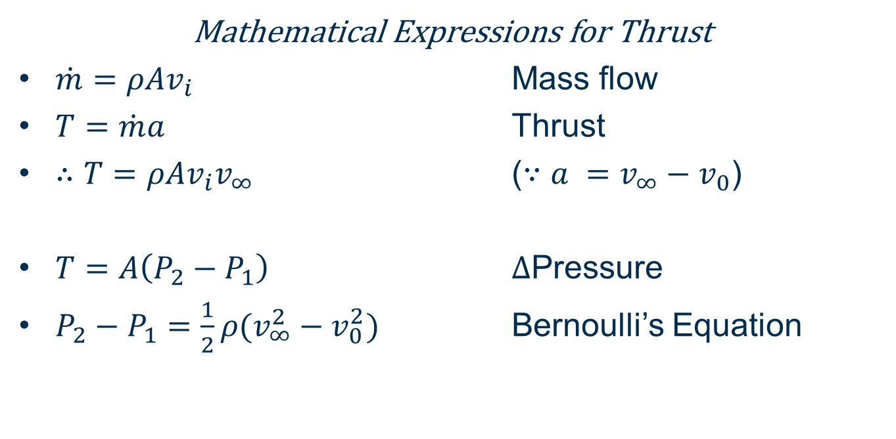
Fundamentals of Flight Theory
Mathematical Expressions for Thrust
$\dot{m}=ρAv_{i}$ Mass flow
$T=\dot{m}a$ Thrust
$∴T=ρAv_{i}v_{∞}$ ($∵a =v_{∞}−v_{0}$)
$T=A\left(P_{2}−P_{1}\right)$ $Δ$Pressure
$P_{2}−P_{1}=\frac{1}{2}ρ(v_{∞}^{2}−v_{0}^{2})$ Bernoulli’s Equation
Notes:
Mass flow
Power into the system takes the form of a pressure differential

Slide 8
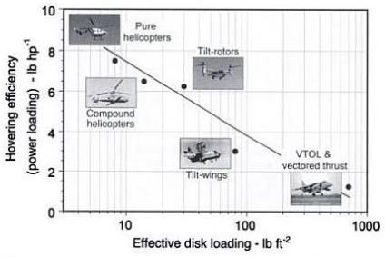
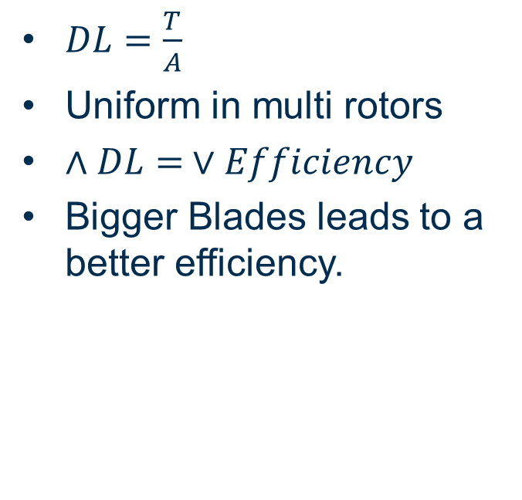
Fundamentals of Flight Theory
Disk Loading
$DL=\frac{T}{A}$
Uniform in multi rotors
$∧DL= ∨Efficiency$
Bigger Blades leads to a better efficiency.
Notes:
It is easier to push large amounts of air slowly, than small amounts of air fast.
Of course bigger blades also leads to: Large rotational inertia, severely limited flight speed, bigger geometry, less immune to gusts.

Slide 9
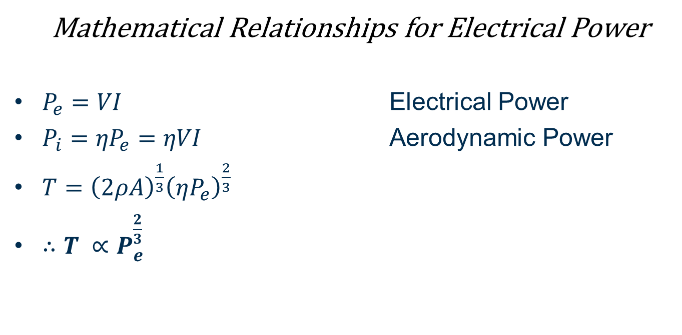
Fundamentals of Flight Theory
Mathematical Relationships for Electrical Power
$P_{e}=VI$ Electrical Power
$P_{i}={ηP}_{e}=ηVI$ Aerodynamic Power
$T={\left(2ρA\right)}^{\frac{1}{3}}{\left(ηP_{e}\right)}^{\frac{2}{3}}$
$∴T ∝P_{e}^{\frac{2}{3}}$
Notes:
Increasing Rotors doubles both the power into the system as well as the thrust where increasing the power only increases the thrust by about 1.5

Slide 10
Selection Parameters
Efficiency, Payload and Flight Time
Geometry, Size and Mechanical Complexity
Flight time linked to efficiency
Single rotor is more efficient than a multi rotor of a similar size.
Multi rotors can handle bigger payloads more efficiently.
Design for light weight
Functional weight distribution.
Symmetrical weight distribution.
Inertia Tensor Reduction

Slide 11
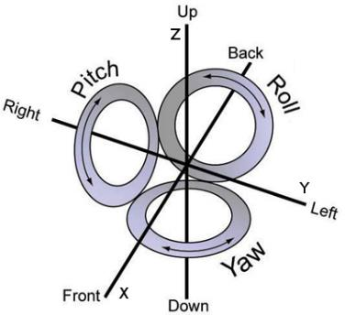
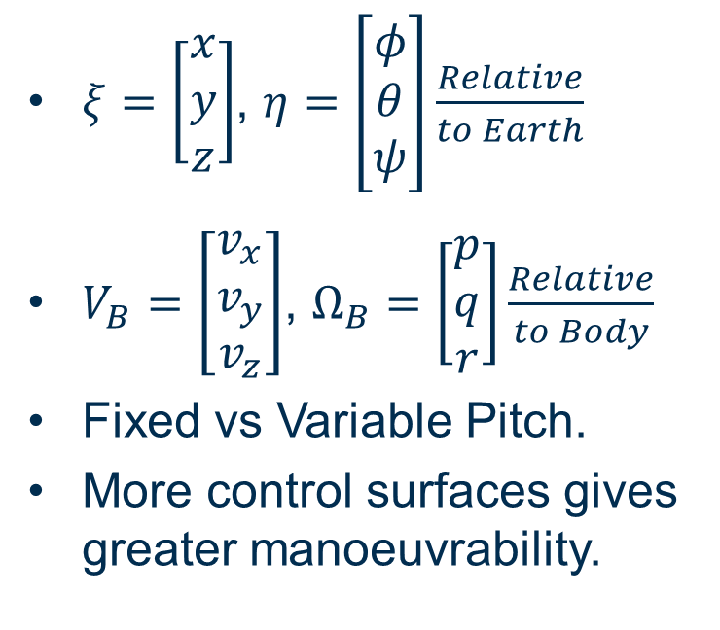
Selection Parameters
Drone Manoeuvrability Control
$ξ=\left[\begin{matrix}x \\ y \\ z\end{matrix}\right]$, $η=\left[\begin{matrix}φ \\ θ \\ ψ\end{matrix}\right]\frac{Relative}{to Earth}$
$V_{B}=\left[\begin{matrix}v_{x} \\ v_{y} \\ v_{z}\end{matrix}\right]$, $Ω_{B}=\left[\begin{matrix}p \\ q \\ r\end{matrix}\right]\frac{Relative}{to Body}$
Fixed vs Variable Pitch.
More control surfaces gives greater manoeuvrability.
Notes:
Rotation Matrix
As angle of attack changes drag increases, power consumption similar.

Slide 12
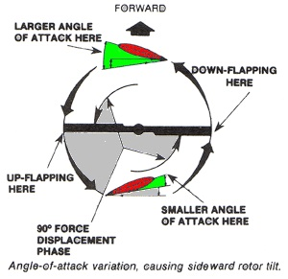
Selection Parameters
Stability and Disturbance Rejection
Big Design Specification for this project.
Inherent Yaw Instability.
Multiple blades increases disturbance immunity.
Rotor loss

Slide 13
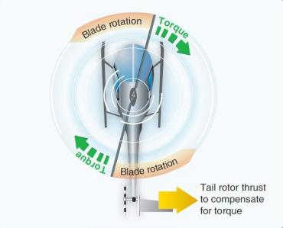
Standard Configurations
Traditional Helicopter
Low disk loading
High efficiency
Lengthy craft
High level of mechanical complexity
Very susceptible to disturbances
Limited payload

Slide 14
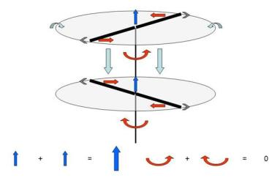
Standard Configurations
Coaxial Rotors
Low disk loading
High efficiency
Compact craft
Weak lateral control
High drag during translations
Limited payload

Slide 15
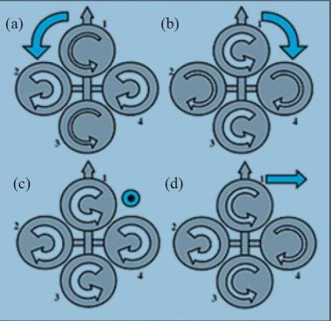
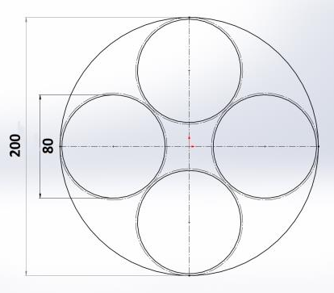
Standard Configurations
Multi Rotors
Very common design
High disk loading
Low efficiency
High payload
High disturbance rejection
Large Craft

Slide 16
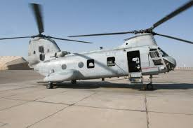
Standard Configurations
Tandem Rotors
Not a commonly used design
Jack of all trades

Slide 17
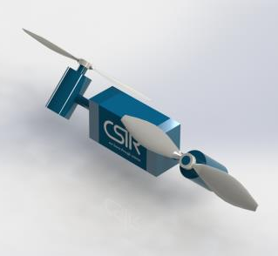
Concept Designs
Concept Design 1 – Tandem Tilt Rotors
Pros
Jack of all trades
Increased manoeuvrability
Compact Design
Cons
Difficult to control
Not much literature

Slide 18
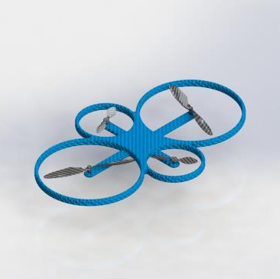
Concept Designs
Concept Design 2 – Unlike Size Quad
Pros
High Stability
Quadcopter manoeuvrability
Compact Design
Easy to control
Higher Payload
High Disturbance rejection
Cons
Lower efficiency

Slide 19
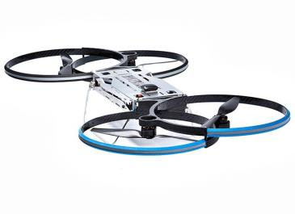
Concept Designs
Concept Design 3 – Overlapping Quad
Pros
High Stability
Quadcopter manoeuvrability
Compact Design
Higher Payload
High Disturbance rejection
Cons
Lower efficiency
Slightly more difficult to control

Slide 20
Thank you
Angus Steele (ASteele@csir.co.za)

